Slide 1
Information Extraction
Part II
Craig Knoblock
University of Southern California
Thanks to Andrew McCallum and William Cohen for overview, sliding windows, and CRF slides. Thanks to Matt Michelson for sides on exploiting reference sets. Thanks to Fabio Ciravegna for slides on LP2.

Slide 2
Landscape of IE Techniques (1/1):
Models
Classify Pre-segmented
Candidates
Lexicons
Sliding Window
Abraham Lincoln was born in Kentucky.
Abraham Lincoln was born in Kentucky.
Abraham Lincoln was born in Kentucky.
member?
Classifier
Alabama
Alaska
…
Wisconsin
Wyoming
Classifier
which class?
which class?
Try alternate
window sizes:
Boundary Models
Finite State Machines
Context Free Grammars
Abraham Lincoln was born in Kentucky.
Abraham Lincoln was born in Kentucky.
Abraham Lincoln was born in Kentucky.
BEGIN
Most likely state sequence?
NNP
NNP
V
V
P
NP
Classifier
Most likely parse?
PP
which class?
VP
NP
VP
BEGIN
END
BEGIN
END
S
…and beyond
Any of these models can be used to capture words, formatting or both.

Slide 3
Boundary Models

Slide 4
(LP)²
Covering algorithm for adaptive IE
  Wrapper Induction-like algorithm
    effective on structured texts
    effective on free texts
    Uses shallow NLP for reducing data sparseness
  (LP)² is the basis for Amilcare
(LP)2=Learning Patterns via Language Processing

Slide 5
Outline
Introduction
Rule Induction
    Tagging and Correction Rules
Data Sparseness & Overfitting
    NLP-based Rule Generalisation
    Rule Set Pruning
Discussion
    Role of NLP-based Generalisation
    Experimental Results

Slide 6
A simple wrapper (LP)
CONDITION: a pattern of conditions on a connected sequence of words
ACTION: operate on single SGML tags (inserting or shifting tags)
</speaker> inserted independently from <speaker>

Slide 7
Use of Rules for IE
IE on test corpus
  Tagging Rules insert tags
  Contextual Rules add further tags:
    inserted tags used as context
    until no tags are added
  Correction Rules shift misplaced tags
  Tag Validation
    removes uncoupled tags

Slide 8
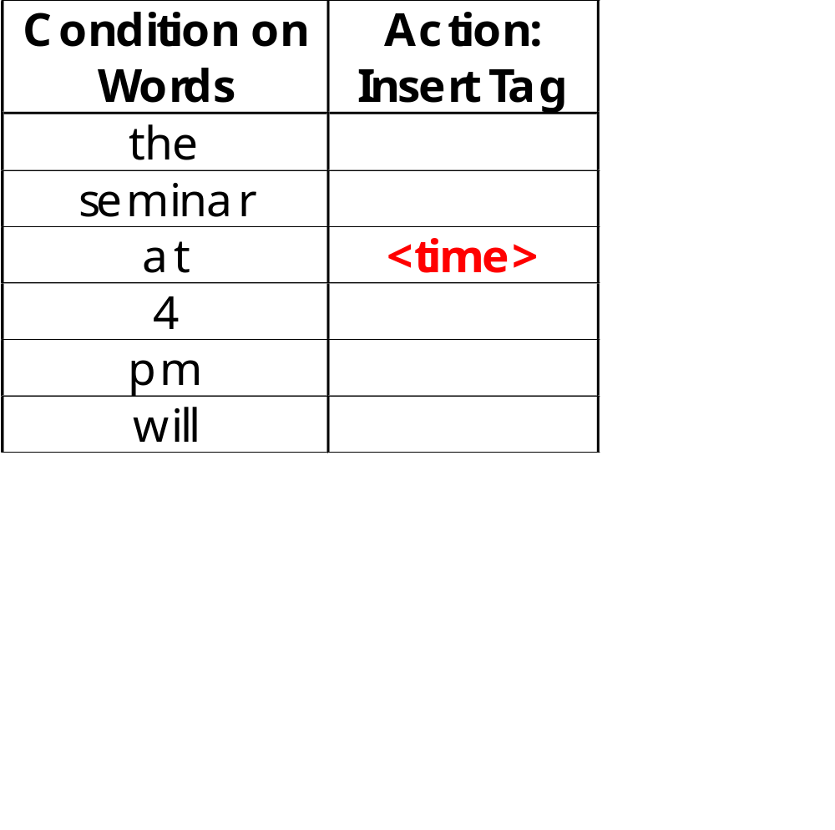
Tagging Rule: example
the seminar at <time> 4 pm will
Initial rule= window of conditions on words

Slide 9
Contextual Rules
Add recall
Low-precision/high-recall rules
Used
  when best rules not able to identify/shift some information
    e.g., missing end or start tag
Surrounding tags used to constrain rule application
The seminar will be given by <speaker> A. Padua </speaker> at <time> 12.30

Slide 10
Imprecision in Tagging
Border identification can be tricky
Up to 5% imprecision for some information
Correction rules shift tags misplaced by tagging rules
  Positive examples: tags misplaced within a distance d from the correct position
  Negative examples: the correct tags

Slide 11
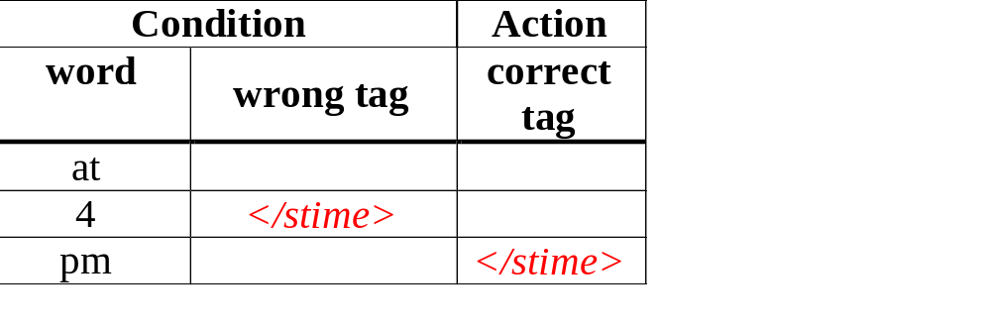
Correction Rule: Example
The seminar at 4 </stime> PM will be held in Room 201
Initial Rule:

Slide 12
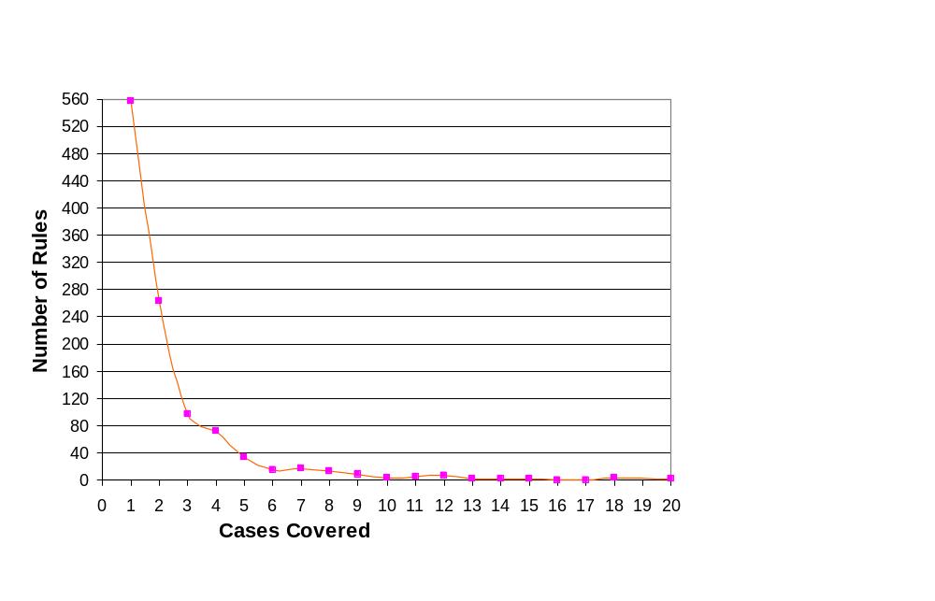
Data Sparseness
Rules relying on word matching tend to:
Report low coverage
    Not able to relate cases
Overfit training corpus
50% rules cover 1 case
71% cover up to 2 cases

Slide 13
Overfitting
Rules with limited coverage overfit the training corpus
  Sensitiveness to mistakes in tagging
    Some good rules not accepted
      Low recall at testing time
    Some bad rules accepted
      Low precision at testing time
Solution:
  Generalise rules to cover larger number of cases
  Prune rule sets

Slide 14
Rule Generalisation
Each instance is generalised by reducing its pattern in length
Generalizations are tested on training corpus
best k rules generated from each instance reporting:
  Smallest error rate (wrong/matches)
  Greatest number of matches
  Cover different examples

Slide 15
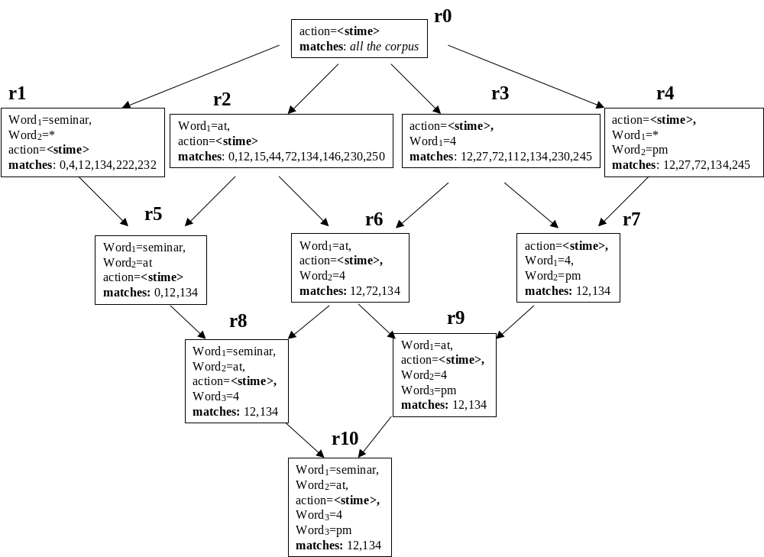

Slide 16
Rule Pruning
Generation time: prune rule if
  error rate>threshold
  coverage too small
  coverage subsumed by more general rule with equivalent error rate
Testing time:
  N-cross folder cycle on training corpus
    Unreliable rules removed
    Error thresholds tuning

Slide 17
NLP-based Adaptive IE
NLP-based approaches
  Effective on newspaper articles (e.g. MUC)
  Ineffective on other types of texts
Why?
  NLP knowledge may be inadequate
    Sublanguage phenomena
    Need of adaptation of generic knowledge
      Need an IE expert
  Unparsability (e.g. HTML pages)

Slide 18
Use of NLP in Wrappers
Need:
  Bridging the gap between NLP-based and Wrapper-like approaches
Proposed solution:
  Wrapper
    has generic NLP knowledge
    learns the level of NLP useful for the task at hand by measuring its effectiveness on the training corpus

Slide 19
Wrapper with NLP-based Generalisation: (LP)²
Conditions on words are replaced by:
  Information from shallow NLP modules
    Capitalisation
    Morphological analysis
      Generalizes over gender/number
    POS tagging
      Generalizes over lexical categories
    User-defined dictionary or gazetteer
All generalizations are tested and the best k derived from each instance are selected

Slide 20
Best Level of Generalization
Rules undergo selection during Learning
  NLP-based generalization is accepted only if useful and does not introduce errors
  Best level of NLP generalization is automatically selected
Heuristics
  If rule matches > n cases then generalization is used
  Otherwise generalization is refused

Slide 21
Experiments
Excellent results wrt state of art
    CMU seminar announcements (E)
    TX-Austin Job Announcements (E)
Application to other corpora
    ITC seminar announcements (mixed I/E)
Commercial Applications
    “Tombstone” data from professional resumees (E)
    IE from financial news (I)
    IE from classified ads (I)
    (…)

Slide 22
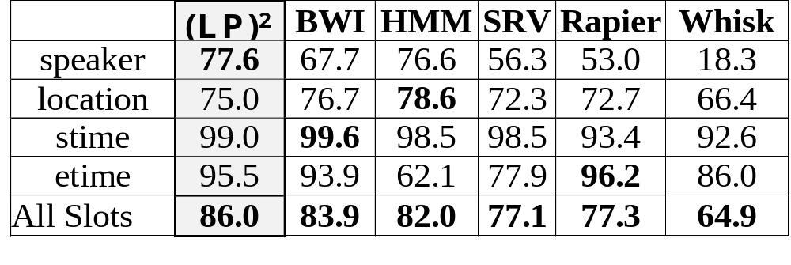
CMU: detailed results
Best overall accuracy
Best result on speaker field
No results below 75%

Slide 23
Algorithm’s Pros
Single tag rules
Contextual rules
Correction rules
NLP-based generalization:
  Reduces data sparseness
  Reduces needed training corpus size

Slide 24
Problems with Sliding Windows and Boundary Finders
Decisions in neighboring parts of the input are made independently from each other.
  Naïve Bayes Sliding Window may predict a “seminar end time” before the “seminar start time”.
  It is possible for two overlapping windows to both be above threshold.
  In a Boundary-Finding system, left boundaries are laid down independently from right boundaries, and their pairing happens as a separate step.

Slide 25
Landscape of IE Techniques (1/1):
Models
Classify Pre-segmented
Candidates
Lexicons
Sliding Window
Abraham Lincoln was born in Kentucky.
Abraham Lincoln was born in Kentucky.
Abraham Lincoln was born in Kentucky.
member?
Classifier
Alabama
Alaska
…
Wisconsin
Wyoming
Classifier
which class?
which class?
Try alternate
window sizes:
Boundary Models
Finite State Machines
Context Free Grammars
Abraham Lincoln was born in Kentucky.
Abraham Lincoln was born in Kentucky.
Abraham Lincoln was born in Kentucky.
BEGIN
Most likely state sequence?
NNP
NNP
V
V
P
NP
Classifier
Most likely parse?
PP
which class?
VP
NP
VP
BEGIN
END
BEGIN
END
S
…and beyond
Any of these models can be used to capture words, formatting or both.

Slide 26
Finite State Machines

Slide 27
Probabilistic Generative Models
Generative Models
  Probability of X and Y → P(X,Y)?
  There is a water bowl, 1 dog, 1 cat and 1 chicken?
    What is probability of seeing dog and cat drink together?
    Look at the # times dog and cat drink together and divide by the # times all animals drink together
Markov assumption: prob. in current state only depends on previous and current state
  Independence:
    You just saw the cat drink, but you can’t use this information to predict the next drinkers!
  Standard model
    Hidden Markov Model (HMM)

Slide 28
Information Ext: Graphical Models
Task: Given an input string, and set of states (labels) with probabilities (we define later)
  What is set of states that produces input sequence?
Input: 2001 Ford Mustang GT V-8 Convertible - $12700
year
model
start
make

Slide 29
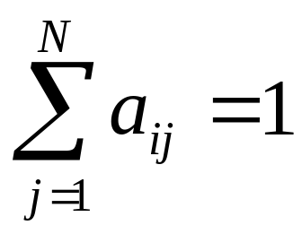
Markov Process: Definitions
  Let’s say we’re independent of time, then we can define
a_{ij} = P(q_{t}=S_{j}|q_{t-1}=S_{i}) as a STATE TRANSITION from S_{i} to S_{j}
  What is the prob. of moving to new state from old state?
    cat/dog drink from no-one drinking?
a_{ij} >= 0
  Conserve “mass” of probability → all outgoing probabilities sum to 1
Taco
0.25
Burger
Hungry
0.10
Soup
0.65

Slide 30
Markov Process: More Defs
Two more terms to define:
  π_{i} = P(q₁=S_{i}) = probability that we start in state S_{i}
  b_{j}(k) = P(k|q_{t} = S_{j}) = probability of observation symbol k in State j.
    “Emission probability”
  So, lets say symbols = {cat,dog}, then we could have something like b1(cat) = P(cat|not-drinking-state)
  i.e. what is the probability that we output cat in not-drinking-state?

Slide 31
Hidden Markov Model
A Hidden Markov Model (HMM)
  Set of states, Set of a_{i,j} , Set of π_{i} ,Set of b_{j}(k)
Training
  From sequences of observations, transition probs (a_{ij}), emission probs (b_{j}(k)), starting probs (π_{i} )
Decoding (after training)
  Input comes in, fits the model’s observations
  Output best state transition sequence that produces input observation
Can observe the sequence of emissions, but you do not know what state the model is in → “Hidden”
If 2 states output “yes”, all I see is “yes,” I have no idea what state or set of states produced this!

Slide 32
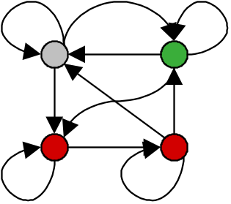

IE with Hidden Markov Models
Given a sequence of observations:
Yesterday Lawrence Saul spoke this example sentence.
and a trained HMM:
Find the most likely state sequence: (Viterbi)
Yesterday Lawrence Saul spoke this example sentence.
Any words said to be generated by the designated “person name”
state extract as a person name:
Person name: Lawrence Saul

Slide 33
HMM Example: “Nymble”
[Bikel, et al 1998],
[BBN “IdentiFinder”]
Task: Named Entity Extraction
Person
end-of-sentence
start-of-sentence
Org
(Five other name classes)
Other
Train on 450k words of news wire text.
Results:
Case Language F1 .
Mixed English 93%
Upper English 91%
Mixed Spanish 90%

Slide 34
Regrets from Atomic View of Tokens
Would like richer representation of text:
multiple overlapping features, whole chunks of text.
Example word features:
  identity of word
  is in all caps
  ends in “-ski”
  is part of a noun phrase
  is in a list of city names
  is under node X in WordNet or Cyc
  is in bold font
  is in hyperlink anchor
  features of past & future
  last person name was female
  next two words are “and Associates”
line, sentence, or paragraph features:
  length
  is centered in page
  percent of non-alphabetics
  white-space aligns with next line
  containing sentence has two verbs
  grammatically contains a question
  contains links to “authoritative” pages
  emissions that are uncountable
  features at multiple levels of granularity
Notes:
1. Prefer richer… one that allows for multiple, arbitrary...
In many cases, for example names and other large vocabulary fields, the identity of word alone is not very predictive because you probably have never seen it before. For example…”Wisneiwski” …not city
In many other cases, such as FAQ seg, the relevant features are not really the words at all, but attributes of the line or para as a whole… emissions=whole lines of text at a time

Slide 35
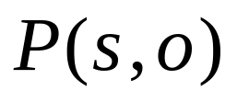
Problems with Richer Representation and a Generative Model
These arbitrary features are not independent:
  Overlapping and long-distance dependences
  Multiple levels of granularity (words, characters)
  Multiple modalities (words, formatting, layout)
  Observations from past and future
HMMs are generative models of the text:
Generative models do not easily handle these non-independent features. Two choices:
  Model the dependencies. Each state would have its own Bayes Net. But we are already starved for training data!
  Ignore the dependencies. This causes “over-counting” of evidence (ala naïve Bayes). Big problem when combining evidence, as in Viterbi!

Slide 36
Conditional Model
We prefer a model that is trained to maximize a conditional probability rather than joint probability:
P(s|o) instead of P(s,o):
  Allow arbitrary, non-independent features on the observation sequence
  Transition probabilities between states might depend on past (and future!) observations
  Conditionally trained:
    Given some observations (your input), what are the likely labels (states) that the model traverses given this input?

Slide 37
Conditional Random Fields (CRFs)
CRFs
  Conditional model
  Based on “Random Fields”
  Undirected acyclic graph
  Allow some transitions “vote” more strongly than others depending on the corresponding observations
  Remember the point: Given some observations, what are the labels (states) that likely produced the observations?

Slide 38
Random Field: Definition
For graph G(V,E), let V_{i} be a random variable
If P(V_{i}|all other V) = P(V_{i}|its neighbors)
Then G is a random field
B
D
A
E
C
P(A | B,C,D,E) = P(A | B,C) → Random Field

Slide 39
CRF: A Conditional random field
Remember, we have observations X and labels Y (states)
Ex) States = {A, B, C, D, E} and some observation Blue
Blue
“first-order chain”
Common in extraction
D
E
C
A
B
A CRF is s.t. P(A | Blue, B, C, D, E) = P(A| Blue, B, C)
Or generally: P(Y_{i}|X, all other Y) = P(Y_{i} | X, neighbors of Y_{i})

Slide 40
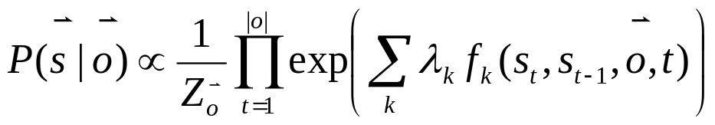
Conditional Random Fields (CRFs)
S_{t}
S_{t+1}
S_{t+2}
S_{t+3}
S_{t+4}
O = O_{t}, O_{t+1}, O_{t+2}, O_{t+3}, O_{t+4}
Markov on s, conditional dependency on o.
Assuming that the dependency structure of the states is tree-shaped (linear chain is a trivial tree), inference can be done by dynamic programming in time O(|o| |S|²)—just like HMMs.
Notes:
Graphical model on previous slide was a special case. In general, observations don’t have to be chopped up, and feature functions can ask arbitrary questions about any range of the observation sequence.
Not going to get into method for learning lambda weights from training data, but simply a matter of maximum likelihood:
This is what trying to maximize, differentiate, and solve with Conjugate Gradient. Again, DP makes it efficient.

Slide 41
CRF: Usefulness
CRF gives us P(label | obs, model)
  Extraction: Find most probable label sequence (y’s), given an observation sequence (x’s)
    2001 Ford Mustang GT V-8 Convertible - $12700
  No more independence assumption
    Conditionally trained for whole label sequence (given input)
      “long range” features (future/past states)
      Multi-features
    Now we can use better features!
      What are good features for identifying a price?

Slide 42
General CRFs vs. HMMs
More general and expressive modeling technique
Comparable computational efficiency
Features may be arbitrary functions of any or all observations
Parameters need not fully specify generation of observations; require less training data
Easy to incorporate domain knowledge
Notes:
…all features used in HMMs can be used here, just discriminatively-trained HMM.
…need not fully specify: I’ll show you a strong example of this later.
…domain knowledge == arbitrary features you make up

Slide 43
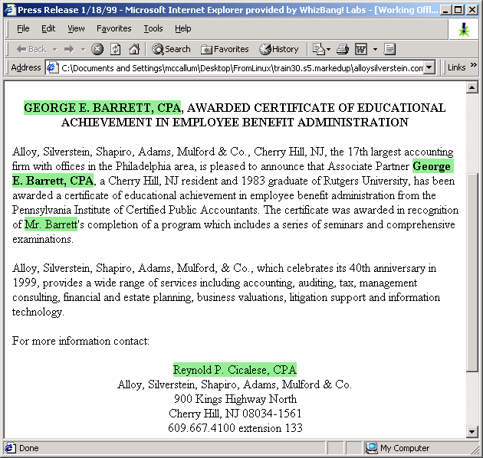
Person name Extraction
[McCallum 2001,
unpublished]
Notes:
Also, just before WhizBang closed I was doing experiments with person name extraction.
From web data, with different definition of name, so again these results are not directly comparable.

Slide 44
Features in Experiment
Capitalized Xxxxx
Mixed Caps XxXxxx
All Caps XXXXX
Initial Cap X….
Contains Digit xxx5
All lowercase xxxx
Initial X
Punctuation .,:;!(), etc
Period .
Comma ,
Apostrophe ‘
Dash -
Preceded by HTML tag
Character n-gram classifier
says string is a person
name (80% accurate)
In stopword list
(the, of, their, etc)
In honorific list
(Mr, Mrs, Dr, Sen, etc)
In person suffix list
(Jr, Sr, PhD, etc)
In name particle list
(de, la, van, der, etc)
In Census lastname list;
segmented by P(name)
In Census firstname list;
segmented by P(name)
In locations lists
(states, cities, countries)
In company name list
(“J. C. Penny”)
In list of company suffixes
(Inc, & Associates, Foundation)
Hand-built FSM person-name extractor says yes, (prec/recall ~ 30/95)
Conjunctions of all previous feature pairs, evaluated at the current time step.
Conjunctions of all previous feature pairs, evaluated at current step and one step ahead.
All previous features, evaluated two steps ahead.
All previous features, evaluated one step behind.
Total number of features = ~200k

Slide 45
Training and Testing
Trained on 65469 words from 85 pages, 30 different companies’ web sites.
Training takes 4 hours on a 1 GHz Pentium.
Training precision/recall is 96% / 96%.
Tested on different set of web pages with similar size characteristics.
Testing precision is 92 – 95%,
recall is 89 – 91%.

Slide 46
MALLET
Machine learning toolkit specifically for language tasks
  http://mallet.cs.umass.edu/index.php/Main_Page
Developed at U. Mass. by Andrew McCallum and his group
  http://www.cs.umass.edu/~mccallum/
For our purposes, we will use the SimpleTagger class which implements Conditional Random Fields

Slide 47
SimpleTagger
Training
  Each line is of the form:
  <feature1> <feature2> … <featureN> <label>
  Let’s start with an example of a sentence:
  Los Angeles is a great city!
  We want to find all nouns, like the example in:
  http://mallet.cs.umass.edu/index.php/SimpleTagger_example

Slide 48
Training CRFs
Let’s say we have some tools that can identify features:
Colors → List of colors
Regex → Apostrophe finder
Regex → Capitalized
Stop-Words → Common tokens: a, the, etc.. (not etc. the word..)
The red bear’s favorite color is green?
STOPWORD
CAPITALIZED
COLOR
APOS

Slide 49
Training CRFs
Note: In SimpleTagger, the default
“ignore” label is O (Used in HW)
GOAL: Find NOUNS
LABELED INPUTS:
The SW CAP not-noun
red COLOR not-noun
bear’s APOS noun
The red bear’s favorite color is green?
STOPWORD
CAPITALIZED
COLOR
APOS

Slide 50
Train SimpleTagger
java -cp "class;lib/mallet-deps.jar" edu.umass.cs.mallet.base.fst.SimpleTagger --train true --model-file SAVEDMODEL TrainingData.txt

Slide 51
Labeling with SimpleTagger
Once you have a trained model, can re-use it to label new data!
java -cp "class;lib/mallet-deps.jar" edu.umass.cs.mallet.base.fst.SimpleTagger --include-input true --model-file SAVEDMODEL NotLabeledText.txt > LabeledOutput.txt

